Slide 1
Behavioral Patterns
JS Patterns and Anti Patterns
Malte Brockmann, Jun Heui Cho

Slide 2
Outline
Behavior Pattern in general
Command
Memento
Patterns and Anti Patterns - Behavioral Patterns - Malte Brockmann, Jun Heui Cho - WS 2015

Slide 3
Behavior Pattern in general
Mainly concerned with the communication between objects.
Patterns and Anti Patterns - Behavioral Patterns - Malte Brockmann, Jun Heui Cho - WS 2015

Slide 4
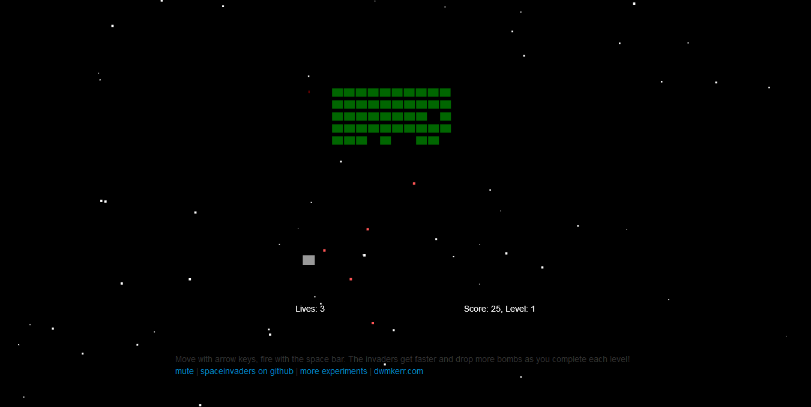
Spaceinvader
Retro Game: shooting Spaceinvader
Level bases
State bases (Welcome-, GameOver-, PlayState, ect.)
Patterns and Anti Patterns - Behavioral Patterns - Malte Brockmann, Jun Heui Cho - WS 2015

Slide 5
Command
Encapsualte a request as an Object
Request without knowing anything about the operation being requestet. - “Black box execute()”
Uses: GUI buttons, Networking, Multi-level undo, Progress bar
Patterns and Anti Patterns - Behavioral Patterns - Malte Brockmann, Jun Heui Cho - WS 2015

Slide 6
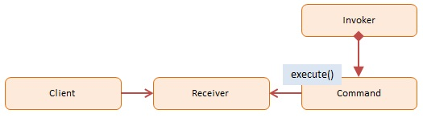
Command - Participans
Client: decides which command at which point
Receiver: knows how to carry out the operatoin
Command: execution()
Invoker: knows how to execute
http://www.dofactory.com/images/diagrams/javascript/javascript-command.jpg
Patterns and Anti Patterns - Behavioral Patterns - Malte Brockmann, Jun Heui Cho - WS 2015

Slide 7
Command - Spaceinvader before
Before:
if(game.pressedKeys[37]) {
this.ship.x -= this.shipSpeed * dt;
}
if(game.pressedKeys[39]) {
this.ship.x += this.shipSpeed * dt;
}
if(game.pressedKeys[32]) {
this.fireRocket();
}
Patterns and Anti Patterns - Behavioral Patterns - Malte Brockmann, Jun Heui Cho - WS 2015

Slide 8
Command - Spaceinvader after 1/2
after:
var goLeft = {
execute : function(obj) {
obj.ship.x -= obj.shipSpeed * dt;
}
}
var goRight = {
execute : function(obj) {
obj.ship.x += obj.shipSpeed * dt;
}
}
var shoot = {
execute : function(obj) {
obj.fireRocket();
}
}
Patterns and Anti Patterns - Behavioral Patterns - Malte Brockmann, Jun Heui Cho - WS 2015

Slide 9
Command - Spaceinvader after 2/2
after:
if(game.pressedKeys[37]) {
goLeft.execute(this);
}
if(game.pressedKeys[39]) {
goRight.execute(this);
}
if(game.pressedKeys[32]) {
shoot.execute(this);
}
Patterns and Anti Patterns - Behavioral Patterns - Malte Brockmann, Jun Heui Cho - WS 2015

Slide 10
Memento
Capturing and externalizing an object’s internal state to be restored later.
Database for “save point”
Use: used to avoid disclosure of implemetnation details
Patterns and Anti Patterns - Behavioral Patterns - Malte Brockmann, Jun Heui Cho - WS 2015

Slide 11
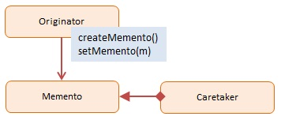
Memento - Participans
Originator: Interface to create and restore mementos
Memento: Ordinator object
Caretaker: stores mementos
http://www.dofactory.com/images/diagrams/javascript/javascript-memento.jpg
Patterns and Anti Patterns - Behavioral Patterns - Malte Brockmann, Jun Heui Cho - WS 2015

Slide 12
Memento - Spaceinvader before 1/3
before:
WelcomeState.prototype.keyDown = function(game, keyCode) {
[…]
game.moveToState(new LevelIntroState(game.level));
};
[…]
GameOverState.prototype.keyDown = function(game, keyCode) […]
game.moveToState(new LevelIntroState(1));
}
Patterns and Anti Patterns - Behavioral Patterns - Malte Brockmann, Jun Heui Cho - WS 2015

Slide 13
Memento - Spaceinvader after 2/3
after:
function Memento(state){
this.state = state;
this.getSavedState = function(){
return this.state;
};
};
function Caretaker(){
var saveState = [];
this.addMemento = function(memento){
saveState.push(memento);
};
this.getMemento = function(index){
return saveState[index];
};
};
Patterns and Anti Patterns - Behavioral Patterns - Malte Brockmann, Jun Heui Cho - WS 2015

Slide 14
Memento - Spaceinvader after 3/3
after:
caretaker = new Caretaker();
[…]
WelcomeState.prototype.keyDown = function(game, keyCode) {
[…]
caretaker.addMemento(new Memento(new LevelIntroState(game.level))); game.moveToState((caretaker.getMemento(0)).getSavedState())
}
};
[…]
GameOverState.prototype.keyDown = function(game, keyCode) {
[…]
game.moveToState((caretaker.getMemento(0)).getSavedState());
}
};
Patterns and Anti Patterns - Behavioral Patterns - Malte Brockmann, Jun Heui Cho - WS 2015

Slide 15
Sources
http://www.dofactory.com/javascript/design-patterns
https://sourcemaking.com/design_patterns
https://en.wikipedia.org/wiki/Command_pattern
https://de.wikipedia.org/wiki/Memento_%28Entwurfsmuster%29
Patterns and Anti Patterns - Behavioral Patterns - Malte Brockmann, Jun Heui Cho - WS 2015

